Slide 1
IP addressing: CIDR
CIDR: Classless InterDomain Routing
subnet portion of address of arbitrary length
address format: a.b.c.d/x, where x is # bits in subnet portion of address
subnet
part
host
part
11001000 00010111 00010000 00000000
200.23.16.0/23

Slide 2
Classless Addressing
Classless addressing is a short term solution to solve the address depletion problem
Uses the same address space but change the distribution of addresses to provide a fair share to each organization.
Still uses the IPv4 addresses (class privilege was removed from the distribution)
The long-range solution already devised called IPv6
The larger address space is obtained by increasing the length of IP addresses (128 bits)
It means that format of IP packets need to be changed

Slide 3
Classless Addressing
In classless addressing, variable-length blocks are assigned that belong to no class.
the entire address space is divided into blocks of different sizes.
Classless addressing
uses a variable number of bits for the network and host portions of the address.
treats the IP address as a 32 bit stream of ones and zeroes,
where the boundary between network and host portions can fall anywhere between bit 0 and bit 31.

Slide 4
Classless Addressing
How to find the prefix length if an address is given?
As prefix length is not inherent in the address
Need to separately give the length of the prefix
So, Prefix length is added to the address, separated by a slash
The notation is informally referred to as slash notation and formally as classless interdomain routing or CIDR
Format of classless addressing address
a.b.c.d /x

Slide 5
Classless Addressing
The network portion of an IP address is determined by how many 1's are in the subnet mask.
A Subnet Mask is used to divide the IP address into network and host addresses
A mask is a 32-bit number in which the n leftmost bits are Is and the 32 - n rightmost bits are 0s
In x.y.z.t/n
x.y.z.t defines one of the addresses and
the /n defines the mask

Slide 6
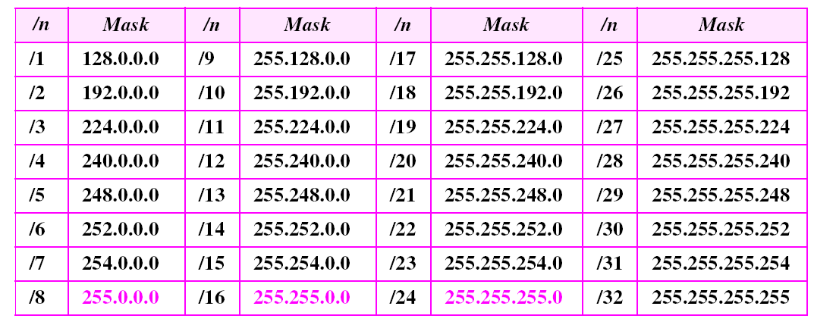
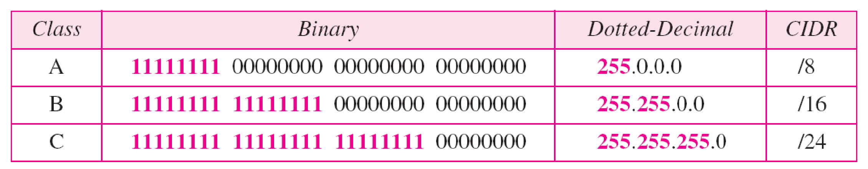
Table Prefix lengths
Thus, Classful addressing is a special case of classless addressing

Slide 7
Example 1: What is the first address in the block if one of the addresses is 167.199.170.82/27?
Solution: The prefix length is 27, which means that we must keep the first 27 bits as is and change the remaining bits (5) to 0s. The following shows the process:
Address in binary: 10100111 11000111 10101010 01010010 Keep the left 27 bits: 10100111 11000111 10101010 01000000 Result in CIDR notation: 167.199.170.64/27

Slide 8
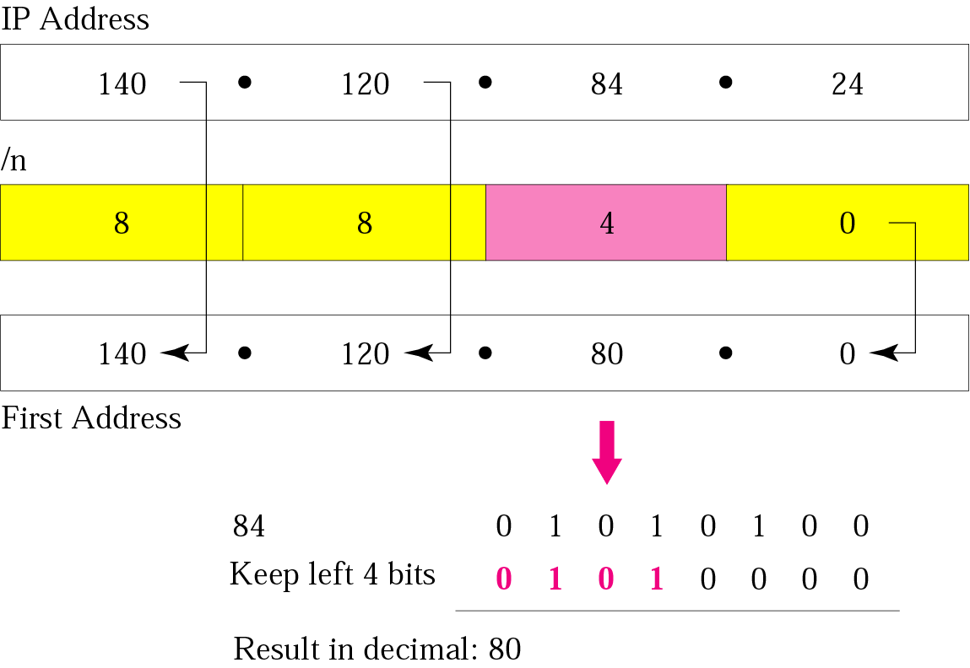
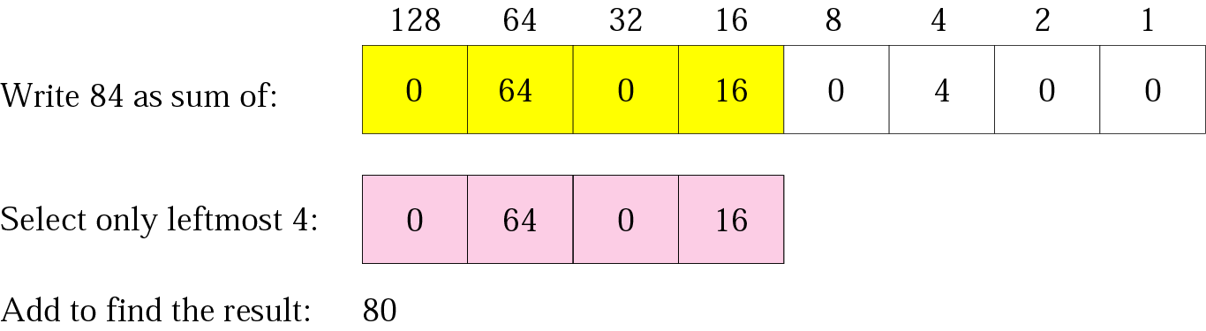
Example 2: What is the first address in the block if one of the addresses is 140.120.84.24/20?
Answer: The first address is 140.120.80.0/20

Slide 9
Example 3: Find the number of addresses in the block if one of the addresses is 140.120.84.24/20.
Solution: The prefix length is 20. The number of addresses in the block is 2³²⁻²⁰ or 2¹² or 4096. Note that this is a large block with 4096 addresses.
Note: The number of addresses can also be found by complementing the mask, interpreting it as a decimal number, and adding 1 to it.

Slide 10
Example 4: find the first and last address in the block if one of the addresses is 140.120.84.24/20.
Answer: The first address is 140.120.80.0/20 (set all bits of host part to 0)
The last address is 140.120.95.255/20 (set all bits of host part to 1)
Another way to find the last address:
Add the mask complement to the beginning address to find the last address.
140 . 120 . 80 . 0 0 . 0 . 15 . 255 ---------------------------- 140 . 120 . 95 . 255

Slide 11
Example 5: Find the block if one of the addresses is 190.87.140.202/29.
Solution: To find the first address, we notice that the mask (/29) has five 1s in the last byte. So write the last byte as powers of 2 and retain only the leftmost five as shown below:
202 ➡ 128 + 64 + 0 + 0 + 8 + 0 + 2 + 0
The leftmost 5 numbers are ➡ 128 + 64 + 0 + 0 + 8
The first address is 190.87.140.200/29
The number of addresses is 2³²⁻²⁹ or 8. To find the last address, use the complement of the mask. The mask has twenty-nine 1s; the complement has three 1s. The complement is 0.0.0.7. Add this to the first address to get 190.87.140.207/29. So, the first address is 190.87.140.200/29, the last address is 190.87.140.207/29. There are only 8 addresses in this block.

Slide 12
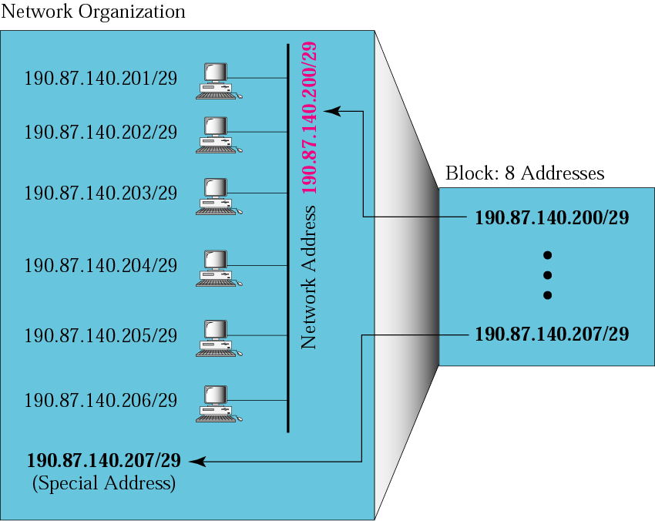
Previous Example: Network Configuration
In classless addressing, the last address in the block does not necessarily end in 255.

Slide 13
In classless addressing, an address can belong to many blocks (depending on value of prefix associated with that block).
For example, the address 230.8.24.56 can belong to
Prefix length | Block
 | From | To
16 | 230.8.0.0 | 230.8.255.255
20 | 230.8.16.0 | 230.8.31.255
26 | 230.8.24.0 | 230.8.24.63
27 | 230.8.24.32 | 230.8.24.63
29 | 230.8.24.56 | 230.8.24.63
31 | 230.8.24.56 | 230.8.24.57

Slide 14
Variable Length Subnet Mask (VLSM)
VLSM is a way of further subnetting a subnet.
we can allocate IPv4 addresses to the subnets by the exact need by using VLSM
VLSM allows us to use more than one subnet mask within the same network address space.
In classful addressing, we can divide a network only into subnets with equal number of IPv4 addresses.
VLSM allows to create subnets from a single network with unequal number of IPV4 addresses

Slide 15
Variable Length Subnet Mask (VLSM)
Suppose we want to divide 192.168.10.0 (a Class C network) into four networks each with unequal number of address requirements as given.
Subnet A : 126 IPv4 Addresses. Subnet B : 62 IPv4 Addresses. Subnet C : 30 IPv4 Addresses. Subnet D : 30 IPv4 Addresses.
Such division is not possible in classful addressing, since it divide the network equally,
but is possible with VLSM.

Slide 16
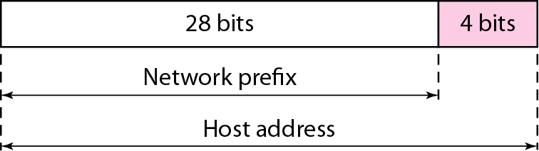
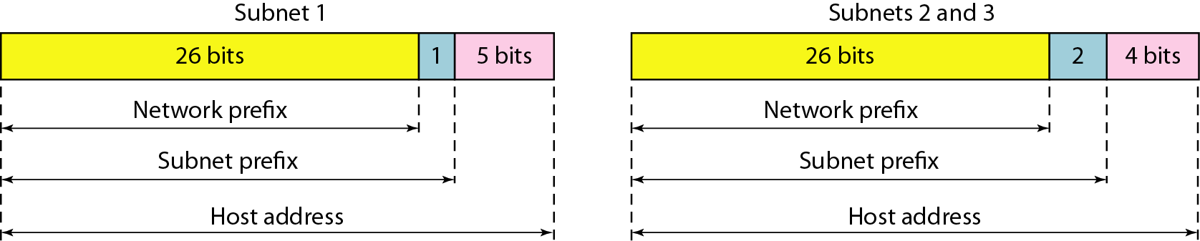
Two-level hierarchy in an IPv4 address
Three-level hierarchy in an IPv4 address

Slide 17
Variable Length Subnet Mask (VLSM)
Division of 192.168.10.0/24 (original network) into four networks with VLSM.
FIRST DIVISION
Divide into two networks equally with 128 addresses (126 usable) using subnet mask 255.255.255.128
Two subnets each with 128 addresses
192.168.10.0/25 [255.255.255.128]
11000000.10101000.00001010.00000000 [in binary] 11111111.11111111.11111111.10000000 [subnet mask]
192.168.10.128/25 [255.255.255.128]
11000000.10101000.00001010.10000000 11111111.11111111.11111111.10000000 [subnet mask]

Slide 18
Variable Length Subnet Mask (VLSM)
SECOND DIVISION
Divide second subnet 192.168.10.128/25 (obtained from first devision) again into two networks, each with 64 addresses (62 usable) using subnet mask 255.255.255.192
Two subnets each with 64 addresses
192.168.10.128/26 [255.255.255.192]
11000000.10101000.00001010.10000000 [in binary] 11111111.11111111.11111111.11000000 [subnet mask]
192.168.10.192/26 [255.255.255.192]
11000000.10101000.00001010.11 000000 11111111.11111111.11111111.11000000 [subnet mask]

Slide 19
Variable Length Subnet Mask (VLSM)
THIRD DIVISION
Divide second subnet 192.168.10.192/26 (obtained from second devision) again into two networks, each with 32 addresses (30 usable) using subnet mask 255.255.255.224
Two subnets each with 64 addresses
192.168.10.192/27 [255.255.255.224]
11000000.10101000.00001010.11000000 [in binary] 11111111.11111111.11111111.11100000 [subnet mask]
192.168.10.224/27 [255.255.255.224]
11000000.10101000.00001010.11100000 11111111.11111111.11111111.11100000 [subnet mask]
So, splitting of 192.168.10.0/24 into four subnets using VLSM with unequal number of addresses is done

Slide 20
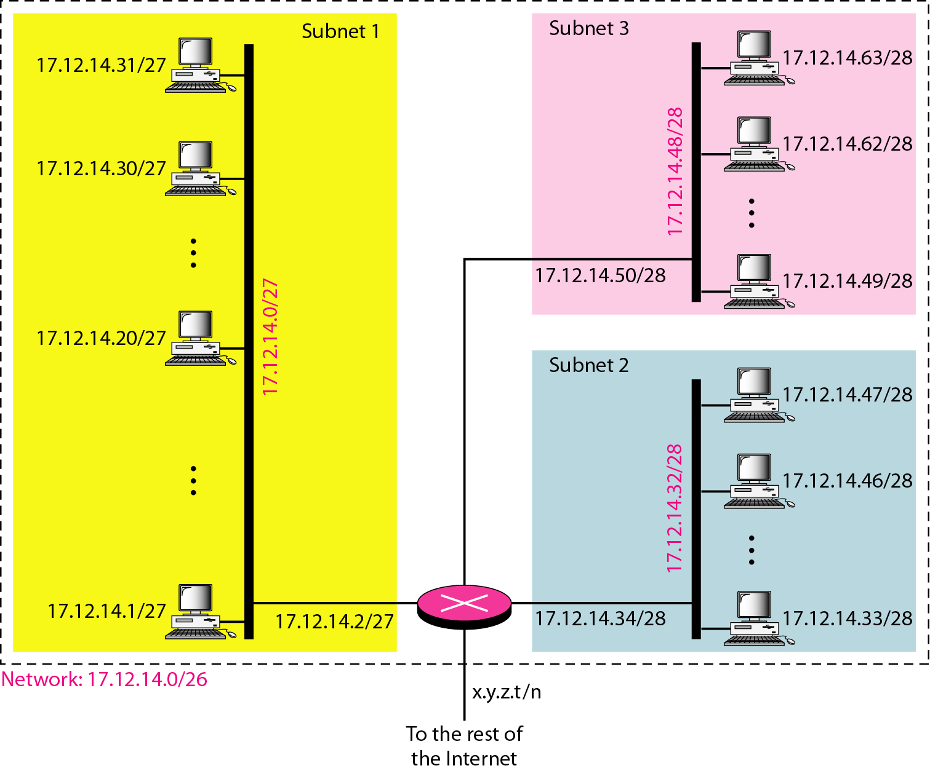
Example: An organization is granted a block of addresses starting with 17.12.14.0/26 (64 addresses). The organization needs to have three sub-blocks of addresses to use in its three subnets: one sub-block of 32 addresses, and two sub-blocks of 16 addresses each.
Design the sub-blocks and find out how many addresses are still available after these allocations.
Configuration and addresses in a subnetted network

Slide 21
Example: An organization is granted a block of addresses starting with 14.24.74.0/24. The organization needs to have three sub-blocks of addresses to use in its three subnets: one sub-block of 10 addresses, one sub-block of 60 addresses, and one sub-block of 120 addresses.
Design the sub-blocks and find out how many addresses are still available after these allocations.
Solution: There are 2 ³²⁻²⁴ = 256 addresses in this block. The first address is 14.24.74.0/24 and last address is 14.24.74.255/24 .
Assign addresses to subblocks starting with the largest and ending with the smallest one.
Mask n1 for the first (largest) subnet 2 ^{32-n1} must be 128 (a number with power of 2 nearest to 120). So n1 = 25. We allocate 128 addresses instead of 120 to this subnet
The first address in this subnet is 14.24.74.0/25 and last address is 14.24.74.127/25

Slide 22
Solution (previous example continue)
Mask for the second subnet 2 ^{32-n2} must be 64 (a number with power of 2 nearest to 60). So n2 = 26
The first address in this subnet is 14.24.74.128/26 and last address is 14.24.74.191/26
Mask for the third subnet 2 ^{32-n3} must be 16 (a number with power of 2 nearest to 10). So n3 = 28
The first address in this subnet is 14.24.74.192/28 and last address is 14.24.74.207/28
So we have 128+64+16 = 208 addresses in all three subblocks.
Therefore, 48 address are still left in reserve.

